Slide 1
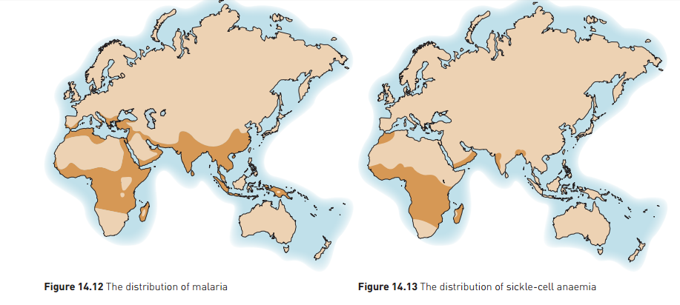
Natural Selection: Heterozygote Advantage
Ch 9 Human Perspectives

Slide 2
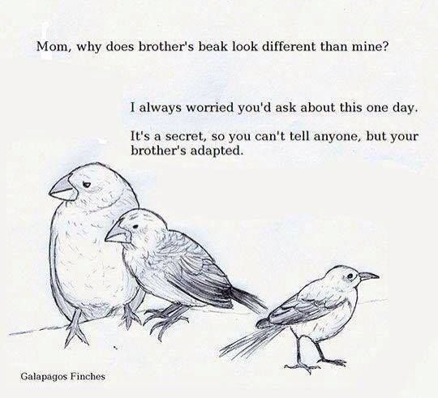
Date: | Human Biology Year 12 ATAR
Do Now Get out your equipment and textbook. Lesson Agenda 1: Do Now 2: Heterozygote Advantage 3: Start on the Review Worksheet 4: Lesson summary and wind-up Suggested Study Complete review worksheet, then mark and correct using the answer key on Connect (compulsory). NEXT LESSON REVISION | Learning Aims Define heterozygote advantage and give examples Discuss causes, inheritance and symptoms of sickle cell anaemia Explain why allele frequency for sickle cell anaemia rises in areas where malaria is present. Discuss causes, inheritance and symptoms of alpha thalassemia Explain why allele frequency for alpha thalassemia rises in areas where malaria is present. Contrast the causes of increased allele frequency for alpha and beta thalassemia Discuss causes, inheritance and symptoms of Tay-Sachs disease. Explain why allele frequency for Tay-Sachs disease may rise in areas where tuberculosis is present.
 | Key Vocabulary Heterozygous Homozygous Allele Selective Agent

Slide 3
Heterozygote Advantage
Heterozygote Advantage is when carrying one allele for a recessive genetic disease is an advantage in a particular environment.
Carriers have a survival advantage.
Allele frequency rises even though there is disadvantage for homozygous recessive people who get the disease.
Examples:
Sickle Cell Anaemia
Alpha Thalassemia
Tay-Sachs Disease
Learning Aim: Define heterozygote advantage and give examples

Slide 4
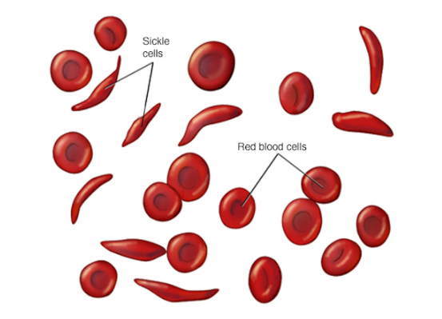
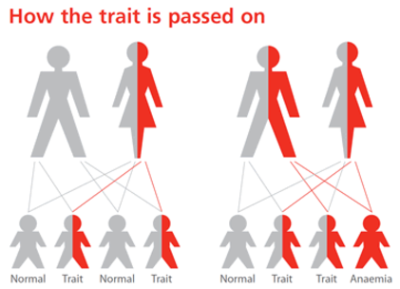
Heterozygote Advantage Example 1: Sickle Cell Anaemia
Varies in incidence throughout the world.
Faulty allele caused by base substitution.
Allele causes “sickle” shape of RBC.
If only one allele inherited (heterozygous):
Only some blood cells are sickled
No symptoms, unless extreme conditions of lower O₂
Carrier of allele – can be passed on to offspring.
If two alleles are inherited (homozygous):
All blood cells affected:
Faulty haemoglobin
Inability to adequately transport oxygen
Death in childhood
Two carriers must reproduce to have a 25% chance of a child being homozygous for sickle cell anaemia.
Learning Aim: Discuss causes, inheritance and symptoms of sickle-cell anaemia

Slide 5
So when is carrying one allele for sickle cell anaemia an advantage?
Using our understandings of natural selection, we would expect the sickle cell allele to decrease in the population over time.
This has happened in most locations; except in areas where there is malaria
There is greater incidence of sickle cell anaemia in areas where malaria is also present because:
Carrying the allele for sickle-cell anaemia protects carriers against malaria
In these areas of the world:
People who inherit two copies of the allele die.
People who inherit one copy are resistant to malaria as a result.
People who inherit no copies (normal blood) are at greater risk of dying from malaria.
Carrying one copy of the sickle cell allele is an advantage compared to carrying no copies or two copies, so the allele frequency is higher in areas where malaria is present.
Learning Aim: Explain why allele frequency for sickle cell anaemia rises in areas where malaria is present

Slide 6
So when is carrying one allele for sickle cell anaemia an advantage?
Areas with no malaria:
greatest advantage is held by individuals with normal blood (no sickle cell allele): they are most likely to survive and bear young.
Areas with malaria:
people with normal blood survive to bear young, but some die from malaria.
People who carry one sickle cell allele survive almost as well: malaria resistance offsets the disadvantage from the sickling allele for carriers.
Therefore the allele is passed on to a greater degree than in areas without malaria.
Presence of malaria acts a selection pressure for the sickle cell allele
Learning Aim: Explain why allele frequency for sickle cell anaemia rises in areas where malaria is present

Slide 7
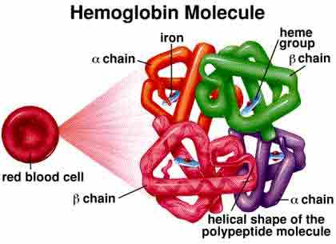
Heterozygote Advantage Example 2: Alpha (α) Thalassemia
Autosomal recessive disease causing defects to haemoglobin production. Often caused by base insertion.
Haemoglobin is made of four proteins.
Two types of thalassemia:
Alpha Thalassemia -
defects to alpha globin
Heterozygote advantage where malaria is present
Symptoms of anaemia and sometimes high iron levels
Beta Thalassemia – defects to beta globin
Defects to beta globin
No evidence of heterozygote advantage
Symptoms of anaemia and sometimes high iron levels
Learning Aim: Discuss causes, inheritance and symptoms of alpha thalassemia

Slide 8
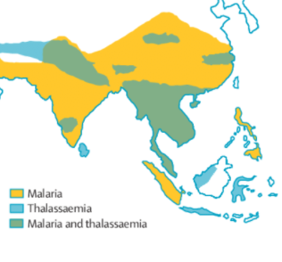
Heterozygote Advantage Example 2: Alpha Thalassemia
Alpha Thalassemia is far more common in areas where malaria is present.
People who are heterozygous for Alpha Thalassemia are less likely to get malaria, or will experience milder symptoms.
Homozygous Dominant: don’t get alpha thalassemia but are more likely to get severe malaria
Heterozygous:
get mild thalassemia but mild or no malaria
this has the best survival in areas with malaria – it is a selective advantage.
due to the survival advantage, people who are heterozygous are more likely
to survive and reproduce – so the allele frequency is higher in populations with
malaria.
Homozygous recessive: die at birth
Learning Aim: Discuss causes, inheritance and symptoms of alpha thalassemia

Slide 9
Heterozygote Advantage Example 2: Alpha Thalassemia
Alpha (α) Thalassemia
Defects in alphaglobin protein structure in haemoglobin cause anaemia
More common in South East Asia
Autosomal recessive inheritance
2 gene loci involved (4 alleles) on chromo 16
Faulty allele for alphaglobin
Homozygous Dominant
no faulty alleles, no anaemia
Heterozygous
some faulty alleles - mild to moderate anaemia
Homozygous recessive
all faulty alleles – fatal at birth
Heterozygote advantage where malaria is present
Beta (β) Thalassemia
Defects in betaglobin protein structure in haemoglobin cause anaemia
More common in the Mediterranean Basin
Autosomal recessive inheritance
1 gene locus involved (2 alleles) on chromo 11
Faulty allele for betaglobin
Homozygous Dominant
No faulty allele, no anaemia
Heterozygous
One faulty allele, mild anaemia
Homozygous recessive
Two faulty alleles, moderate to severe anaemia.
No evidence of heterozygote advantage where malaria is present
Learning Aim: Contrast causes of increased allele frequency for alpha and beta thalassemia

Slide 10

Beta Thalassemia – no evidence for heterozygote advantage
Beta thalassemia is more common in countries around the Mediterranean Basin, but there is no evidence for heterozygote advantage.
So why is the allele frequency for beta thalassemia greater around the Mediterranean?
Due to (historically) restricted gene pool with sociocultural barriers to gene flow.
Mutation to cause beta thalassemia occurred at some time in the past, in that area.
Cultures in the Mediterranean often had cousin marriage to maintain power and wealth, therefore a barrier to gene flow.
Due to breeding within a closed population, the alleles persist at a higher frequency than in other populations.
Learning Aim: Contrast causes of increased allele frequency for alpha and beta thalassemia

Slide 11
Heterozygote Advantage Example 3: Tay Sachs Disease
Lethal recessive trait
Faulty allele for production of enzyme hexosaminidase, involved in lipid metabolism
Inheriting no faulty alleles (homozygous dominant)
Enzyme is correctly produced, no disease
Inheriting one faulty allele (heterozygous)
No disease as the working allele produces the hexosaminidase.
Allele can be passed to offspring
Heterozygote advantage in areas where tuberculosis is present
Inheriting two faulty alleles (homozygous recessive)
Buildup of lipids called gangliosides in the brain
Progressive deterioration of CNS activity
Death in infancy or early childhood
In most populations, the most advantageous genotype is to be carrying no alleles for Tay-Sachs. For this reason, the allele decreases in the population over time. In communities with tuberculosis, people heterozygous for Tay Sachs disease are less likely to get tuberculosis. In this case, being heterozygous is a survival advantage.
In small populations affected by tuberculosis, the allele frequency will rise in the population.
Learning Aim: Discuss causes, inheritance and symptoms of Tay-Sachs Disease, and explain why allele frequency may rise in areas where Tuberculosis is present

